Slide 1
Deep Learning For OCT Image
경상대학교 정보통신공학과
이윤환, 김동휘, 김지연, 김진현, 이웅섭
2020.06.11

Slide 2
목차
데이터, 데이터전처리
Model test
- Xception, InceptionV3, Vgg19, DenseNet121, ResNet50
3. CAM을 이용한 특징 시각화

Slide 3
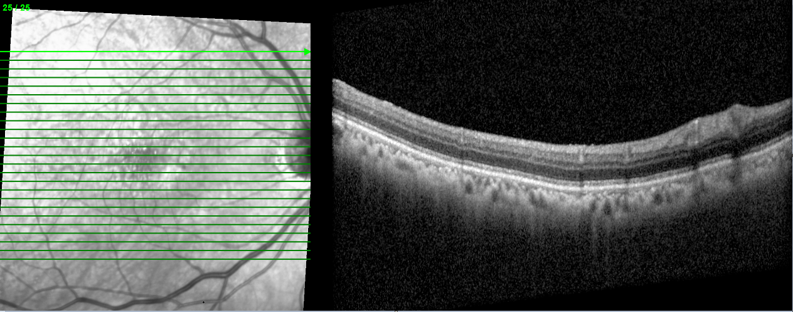
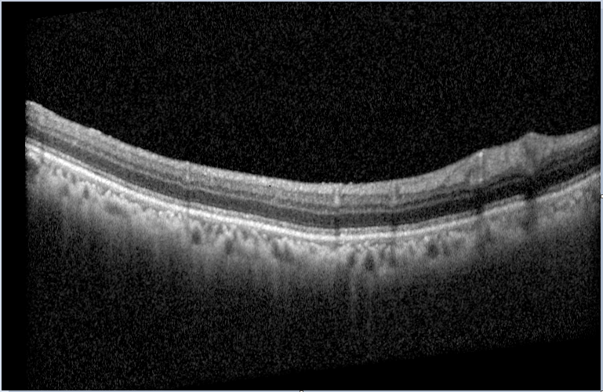
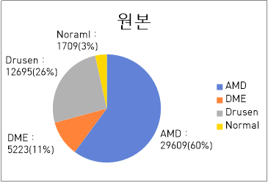
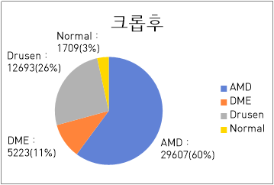
데이터
 | 원본 | 원본=>크롭
AMD | 29609 | 29067 (-2)
DME | 5223 | 5223
Drusen | 12695 | 12693 (-2)
Normal | 1709 | 1709
Total | 49236 | 49232
모델 테스트에 필요한 부분만 추출

Slide 4
Result
 | Total | Xception | InceptionV3 | Vgg19 | DenseNet121 | Resnet50
DME | 5,223 | 3,449 (66%) | 3,187 (61%) | 2,191 (41%) | 2,699 (51%) | 3,168 (60%)
Negative_DME |  | 1,772 (34%) | 2,034 (39%) | 3,030 (59%) | 2522 (49%) | 2,053 (40%)
DRUSEN | 12,693 | 1,650 (13%) | 2,431 (19%) | 5,280 (41%) | 1,772 (13%) | 1,450 (11%)
Negative_DRUSEN |  | 11,047 (87%) | 10,266 (81%) | 7,417 (59%) | 10,925 (87%) | 11,247 (89%)
NORMAL | 1,709 | 1,242 (72%) | 1,099 (64%) | 693 (40%) | 1,389 (81%) | 1,245 (72%)
Negative_NORMAL |  | 467 (28%) | 610 (36%) | 1,016 (60%) | 320 (19%) | 464 (28%)

Slide 5
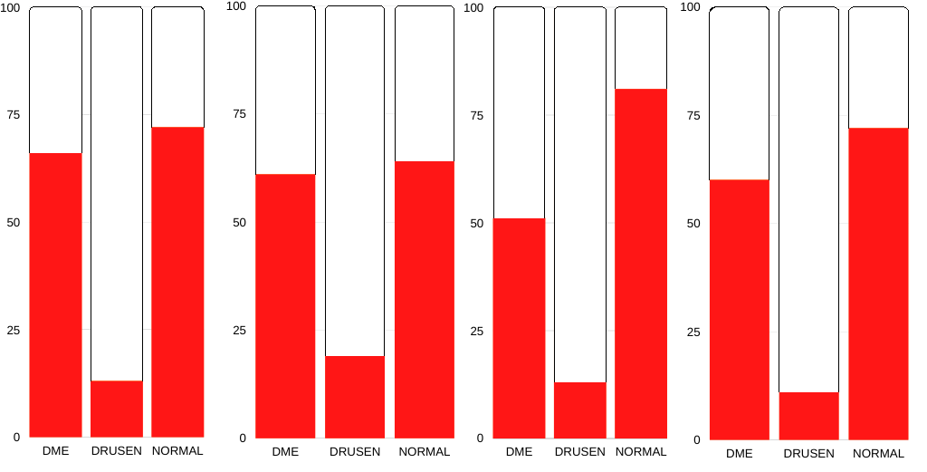
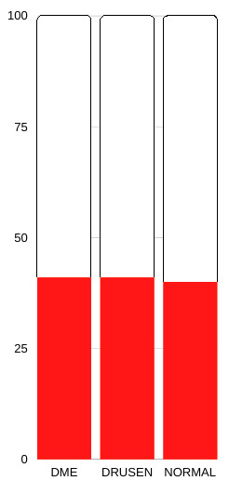
Bar Chart
Positive
Negative
Xception
InceptionV3
DenseNet 121
ResNet50
VGG19

Slide 6
Negative Result
 | Xception | InceptionV3 | Vgg19 | DenseNet121 | Resnet50
DME->CNV | 247 (5%) | 419 (8%) | 1285 (25%) | 271 (5%) | 437 (8%)
DME->DRUSEN | 130 (2%) | 250 (5%) | 720 (14%) | 140 (3%) | 99 (2%)
DME->NORMAL | 1,395 (27%) | 1,365 (26%) | 1,025 (20%) | 2,111 (40%) | 1,517 (29%)
DRUSEN->CNV | 431 (3%) | 691 (5%) | 1580 (12%) | 132 (1%) | 571 (5%)
DRUSEN->DME | 952 (7%) | 1,008 (8%) | 303 (2%) | 320 (3%) | 1,024 (8%)
DRUSEN->NORMAL | 9,664 (77%) | 8,567 (67%) | 5,534 (44%) | 10,473 (82%) | 9,652 (76%)
NORMAL->CNV | 244 (14%) | 379 (22%) | 511 (30%) | 186 (11%) | 224 (13%)
NORMAL->DME | 206 (12%) | 182 (10%) | 25 (1%) | 128 (7%) | 203 (12%)
NORMAL->DRUSEN | 17 (0.1%) | 49 (3%) | 480 (28%) | 6 (1%) | 37 (2%)

Slide 7
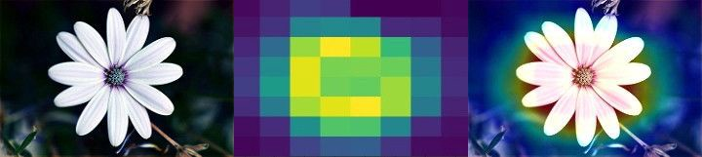
Class Activation Map(CAM)
모델의 마지막 컨볼루션 Layer를 통해 얻은 feature map을 이용.

Slide 8
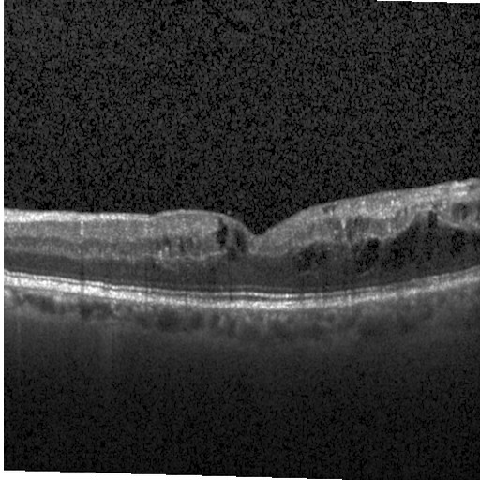
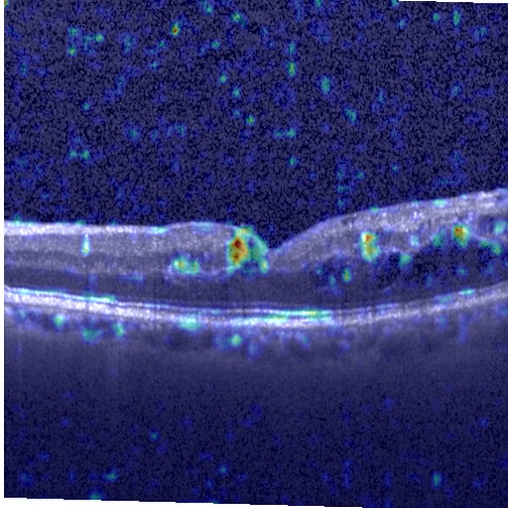
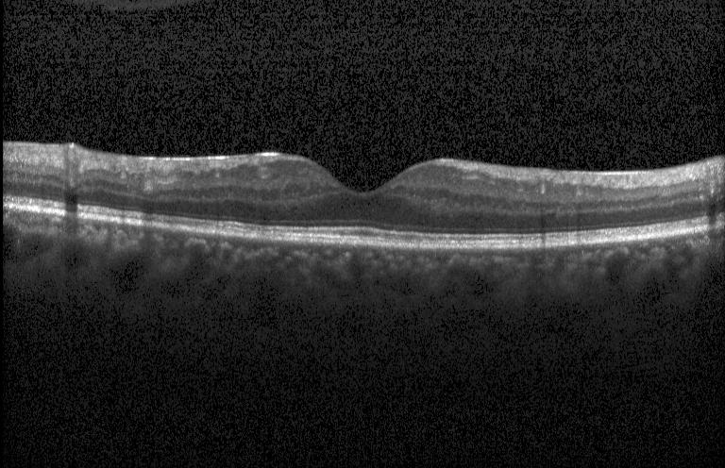
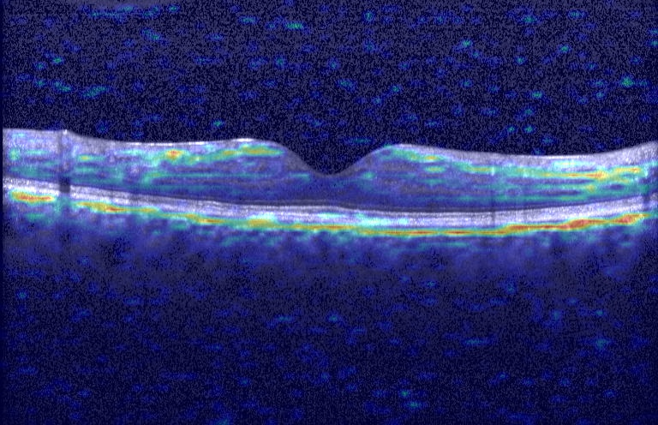
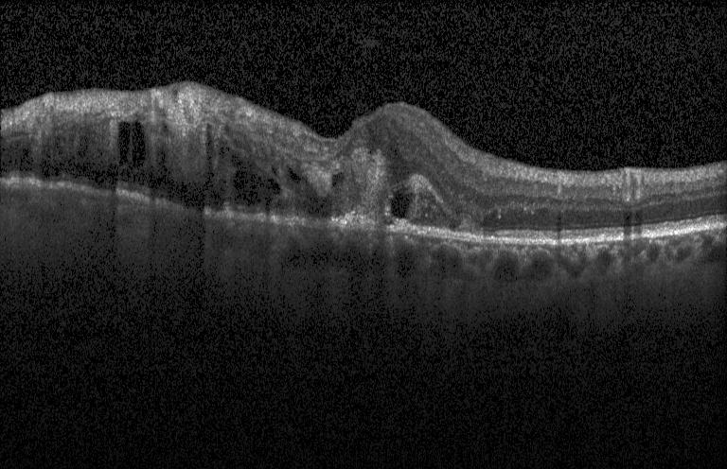
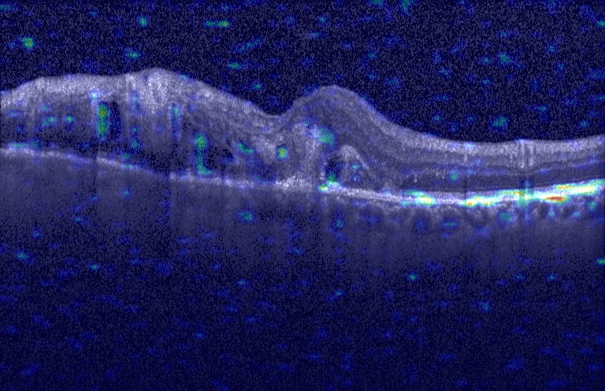
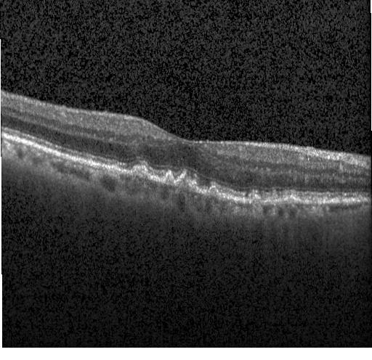
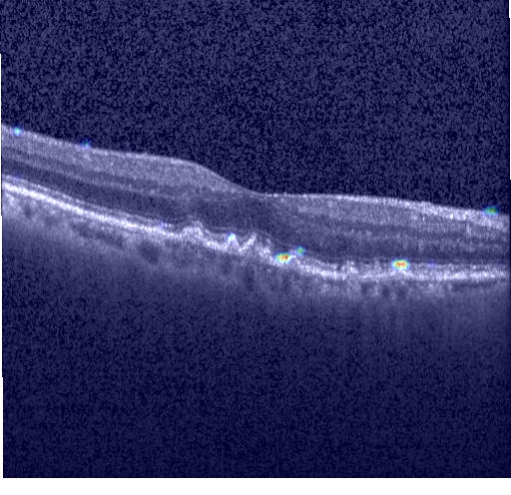
특징 시각화
Normal image
DME image
CNV image
DRUSEN image

